Slide 1
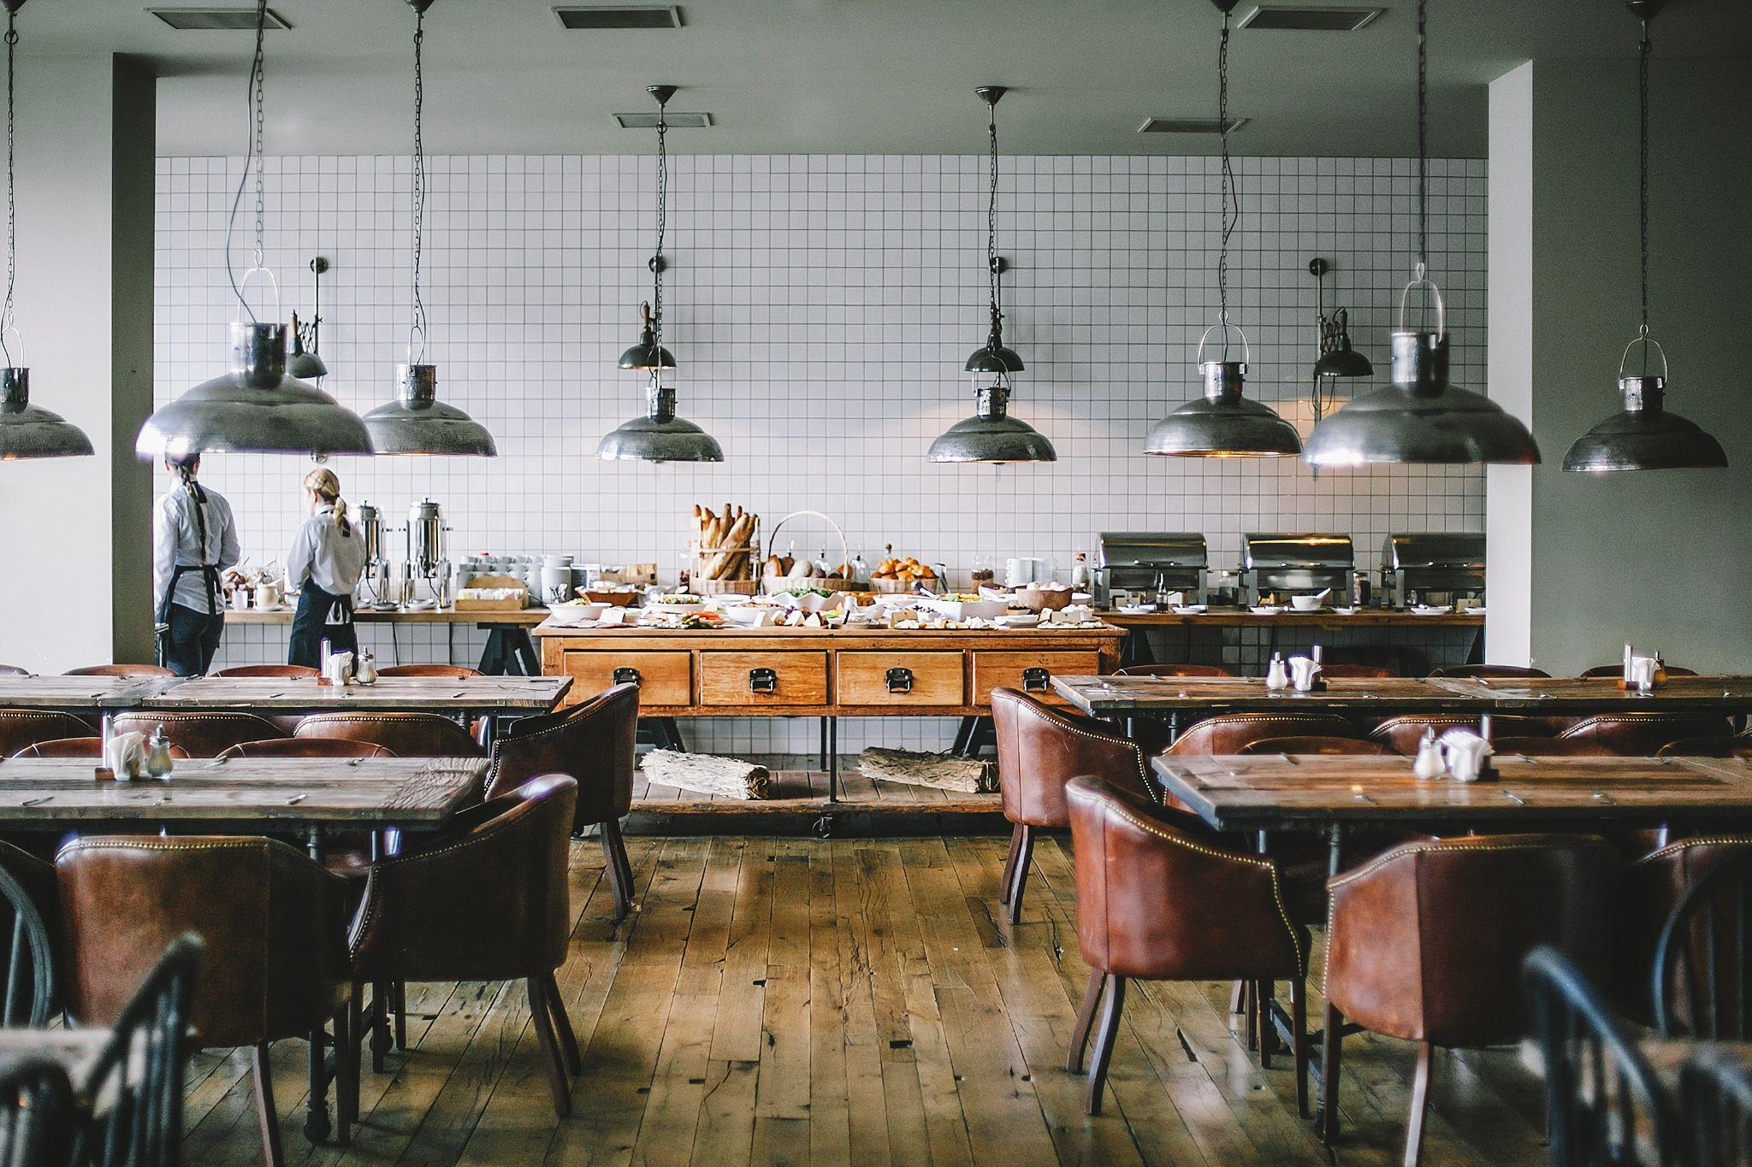
THE 4-WARD THINKERS
Adarsh Sood
Colton Baker
Kushagra Sharma
Mazda Farrahi

Slide 2
THE DESIGN PROBLEM
01
02
CONCEPT GENERATION
TABLE OF CONTENTS
03
OUR SOLUTION
WORKING AND MECHANISMS (FUNCTIONAL ANALYSIS)
04
05
BATTERY LIFE AND CHARGING
06
COSTS

Slide 3

Design Problem
Semi-Technical
Increase in demand alongside with shortage of staff leading to unsatisfactory customer service.
Need an alternative solution to provide consistent timely service and improve the customers’ experience.
Create an affordable, scalable, mass-manufacturable, and efficient load-carrying automated robotic meal serving system.

Slide 4
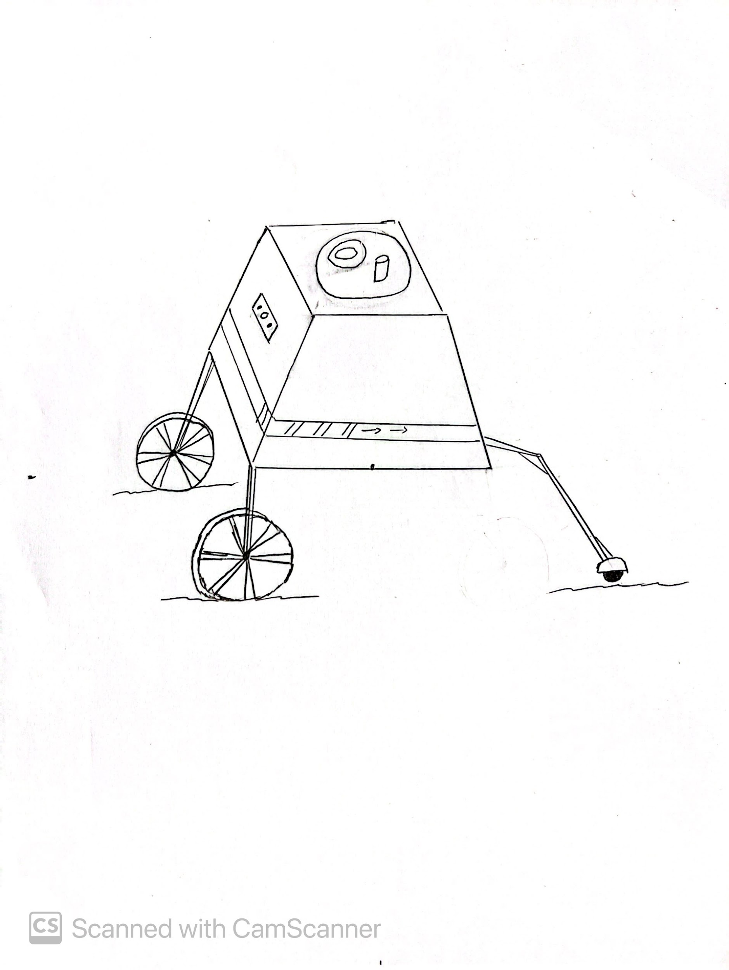
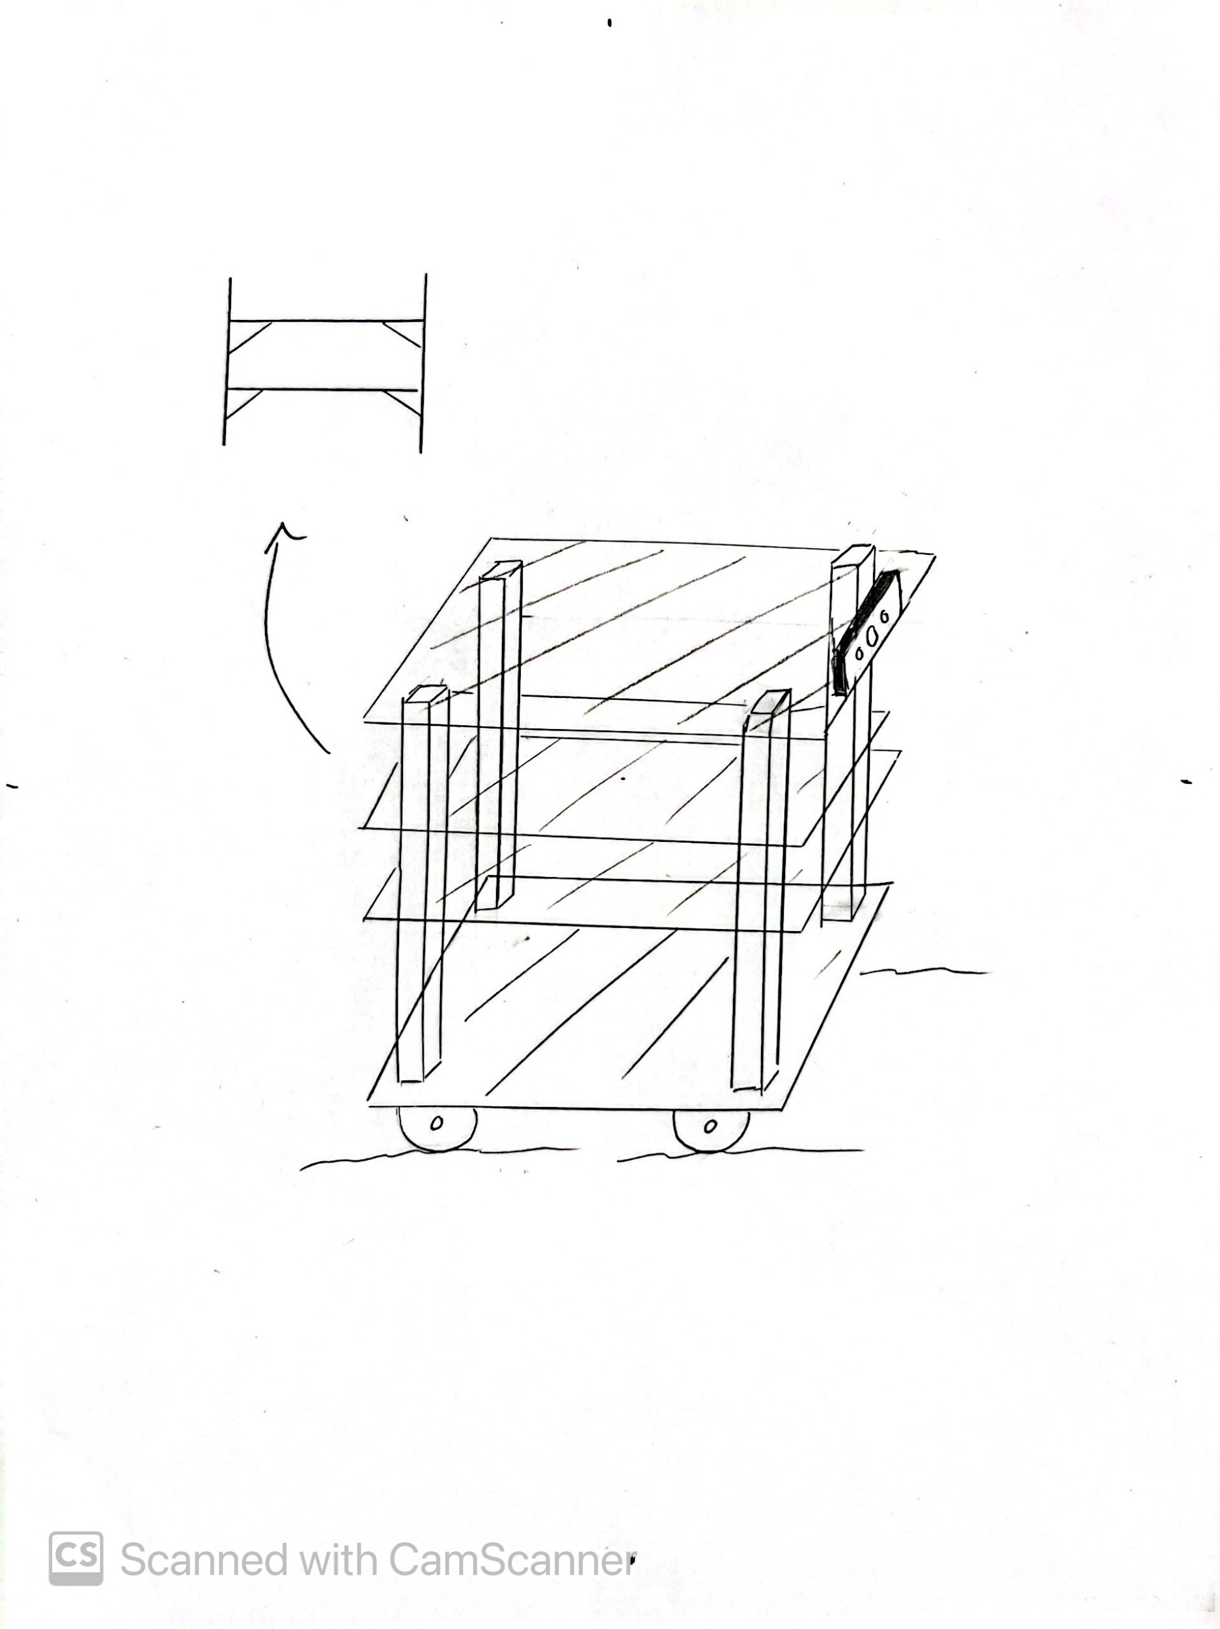
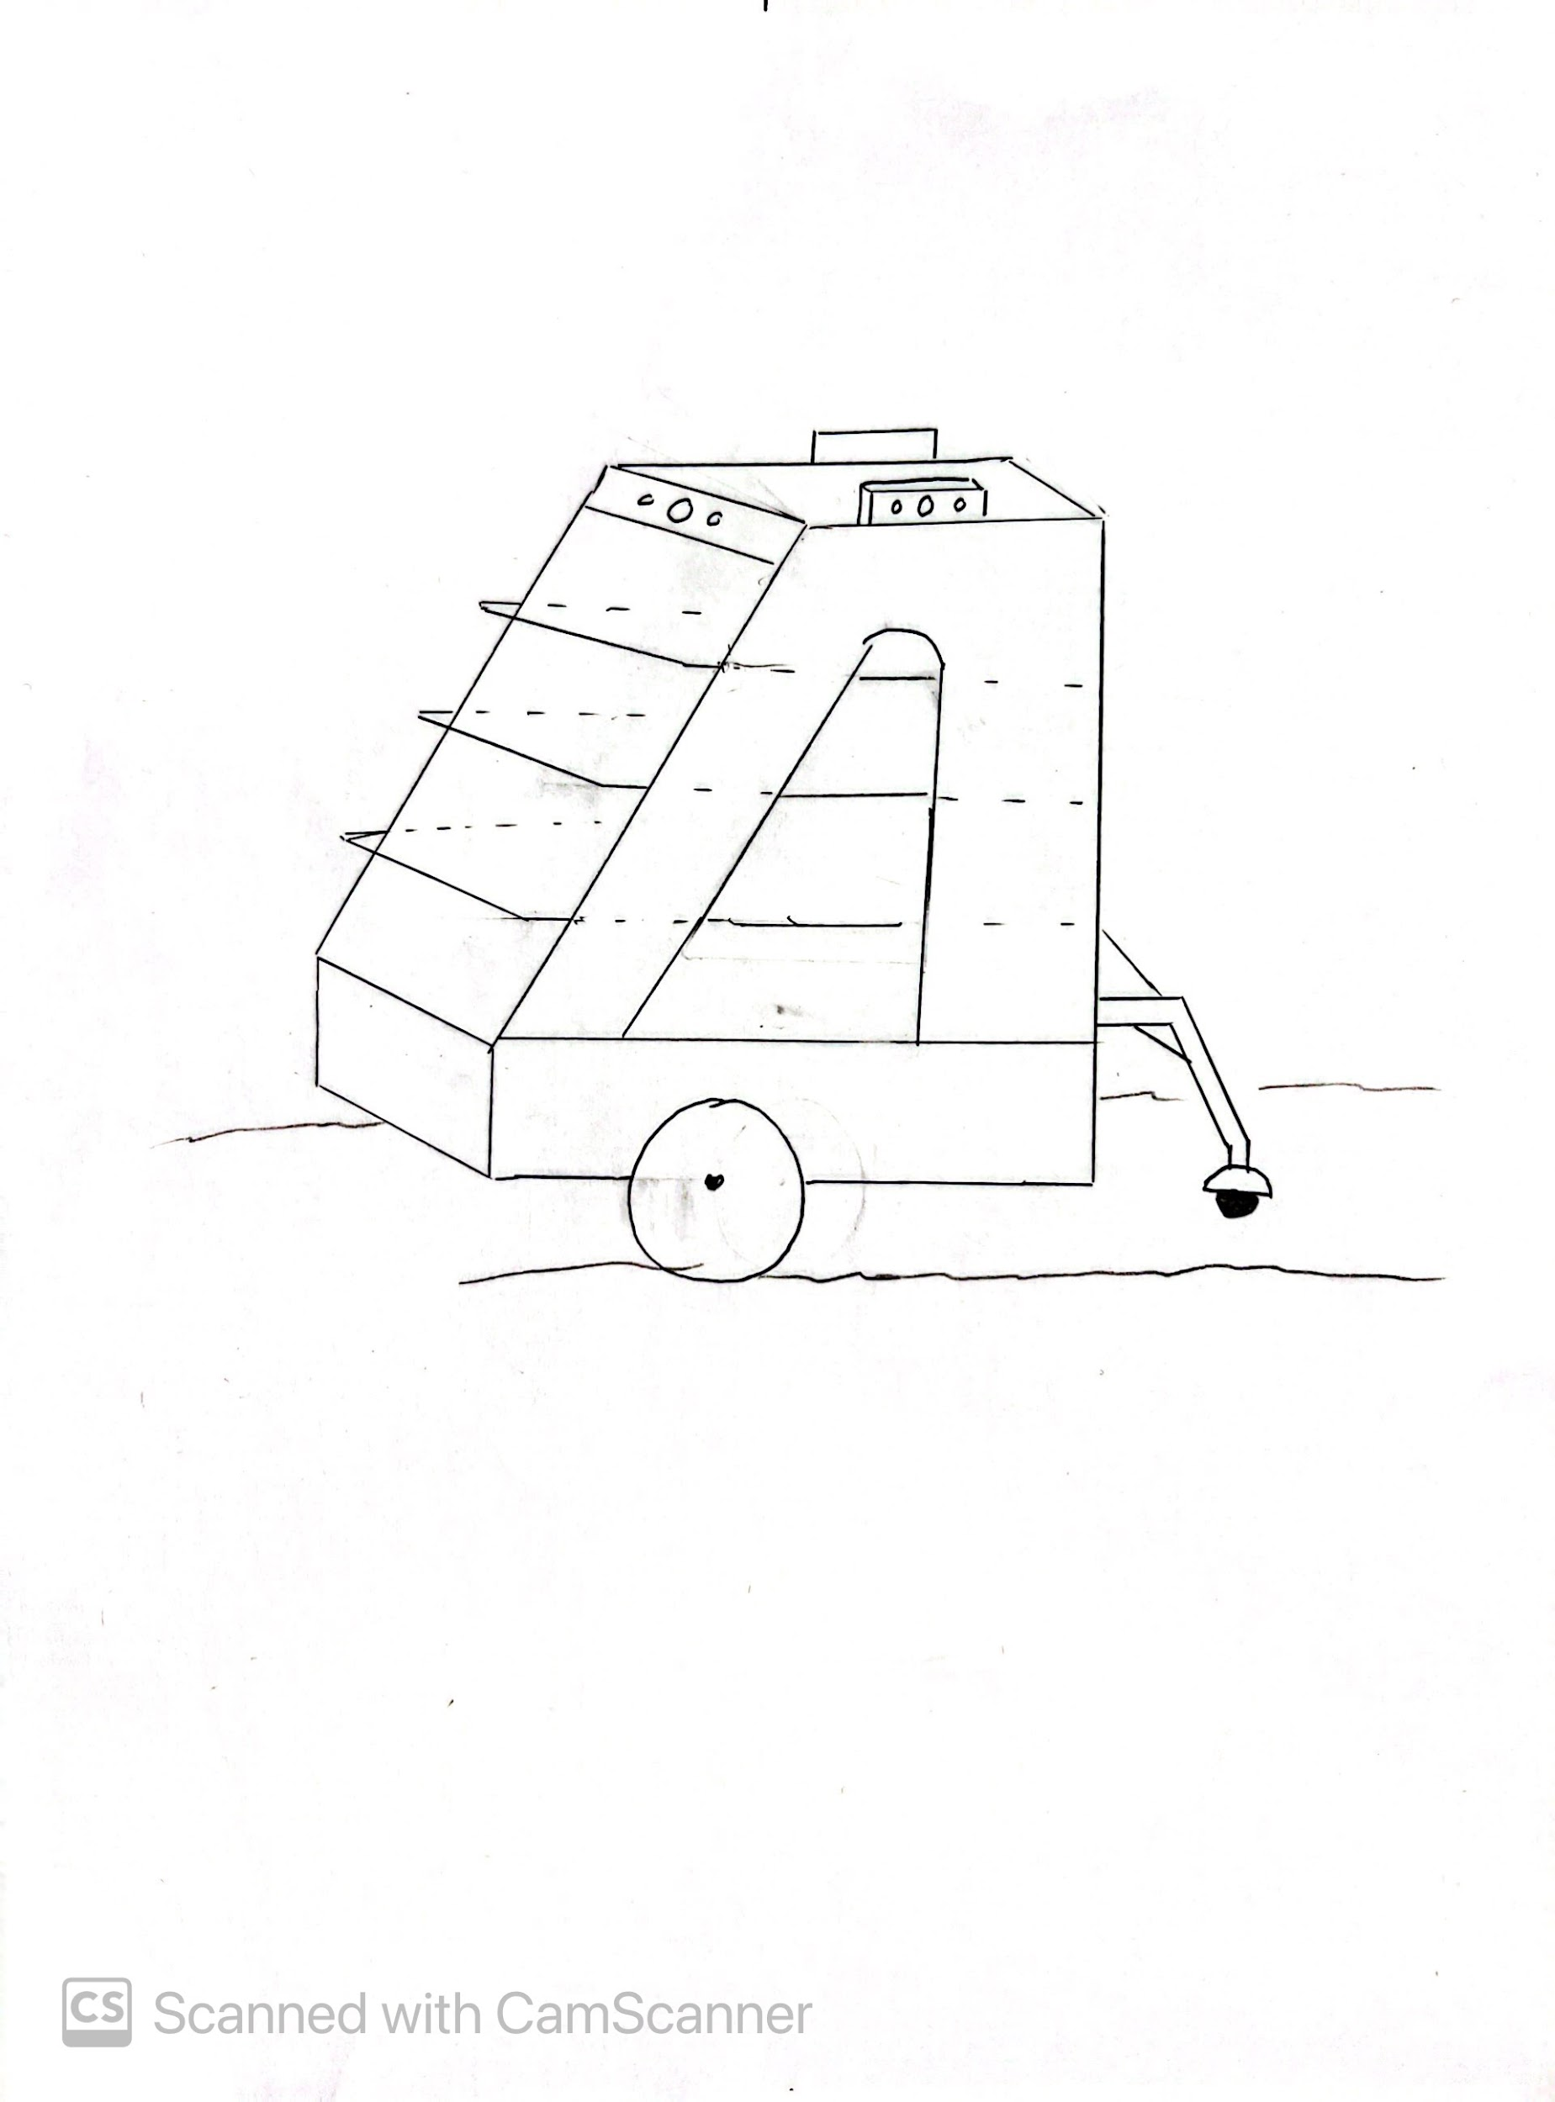
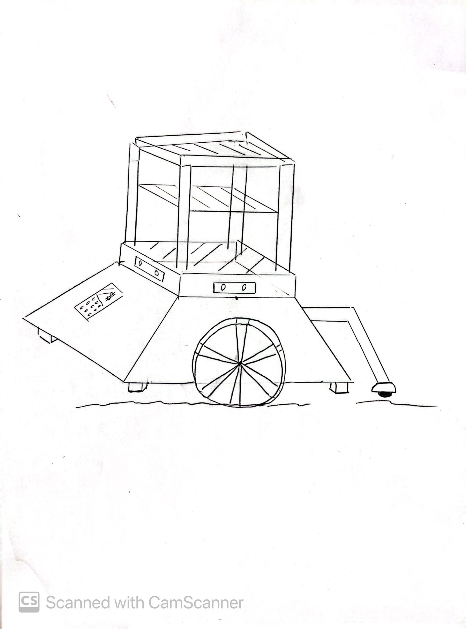
C-SKETCHES (Concept Generation)
Mercury is the closest planet to the Sun and the smallest one in our Solar System—it’s only a bit larger than our Moon. The planet’s name has nothing to do with the liquid metal, since it was named after the Roman messenger god

Slide 5
Main Technical Risks : Risk Register
ID | Risk | Sev. | Like. | Rating | Action
1. | - Raspberry Pi or electronic components fail - Programming Errors - Loose Wires | 3 | 2 | 6 | Ensure no programming and wiring errors.
2. | - More complex design = greater ability, at the risk that more could go wrong | 2 | 2 | 4 | Find a balance between simple and complicated designs
3. | - Conserving material by reducing thickness and surface area, reduces the strength | 1 | 2 | 2 | Save material only where necessary

Slide 6
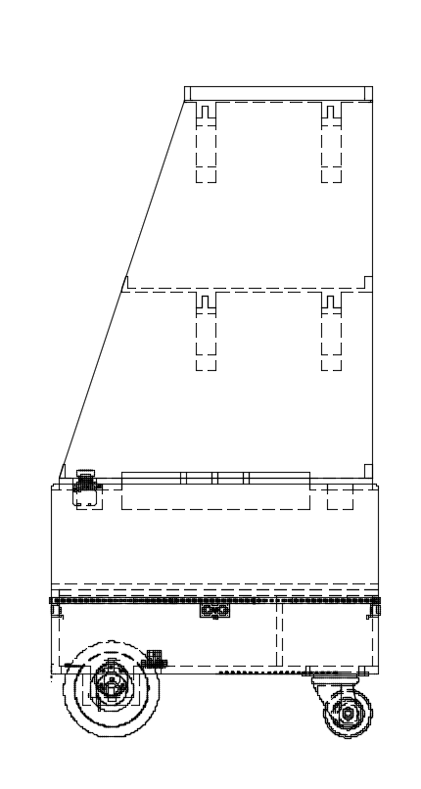
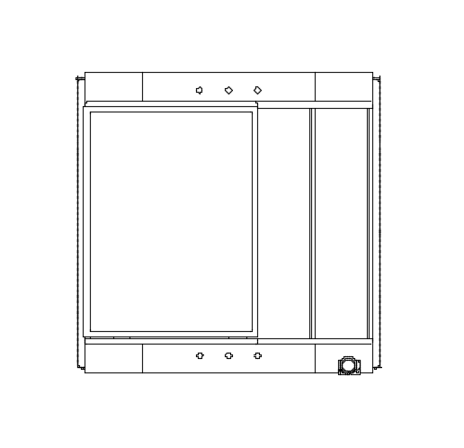
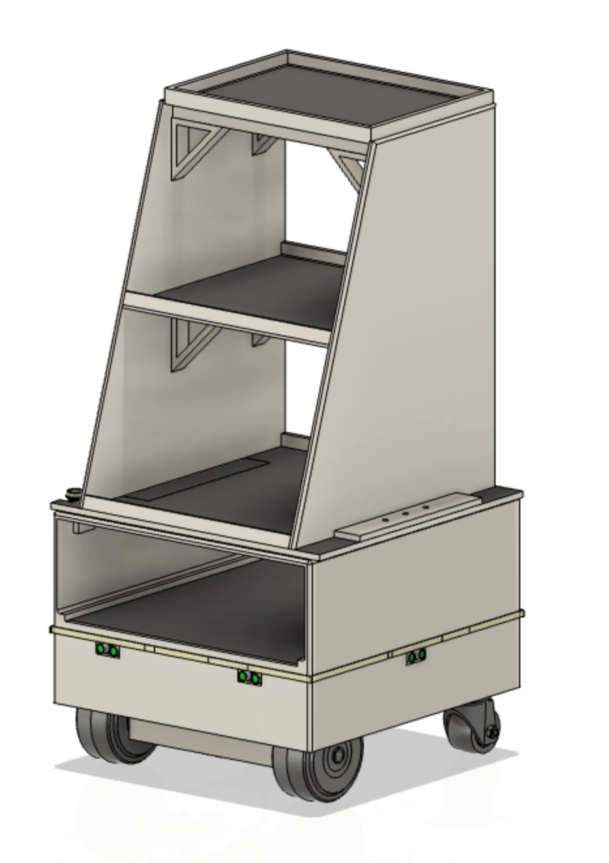
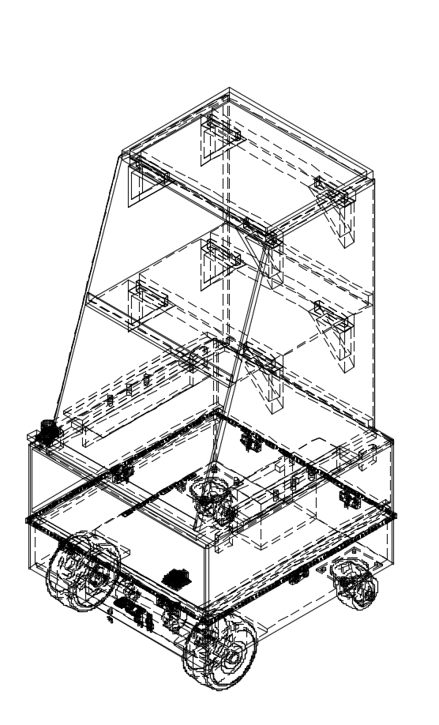
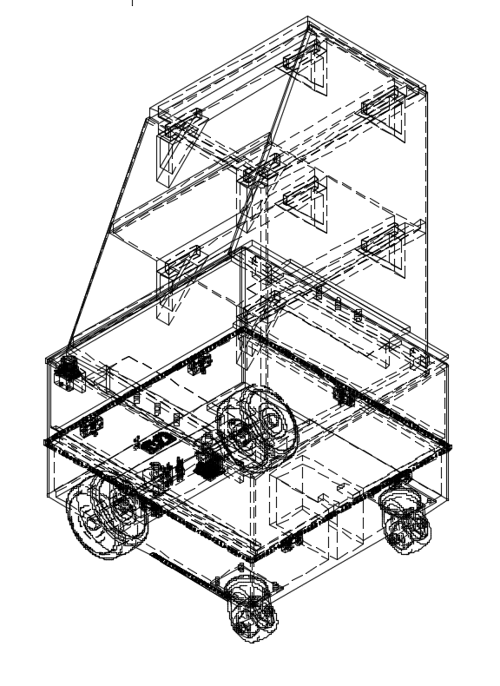
Our Solution: The 4-Ward Thinker
102 cm
52 cm
52 cm

Slide 7
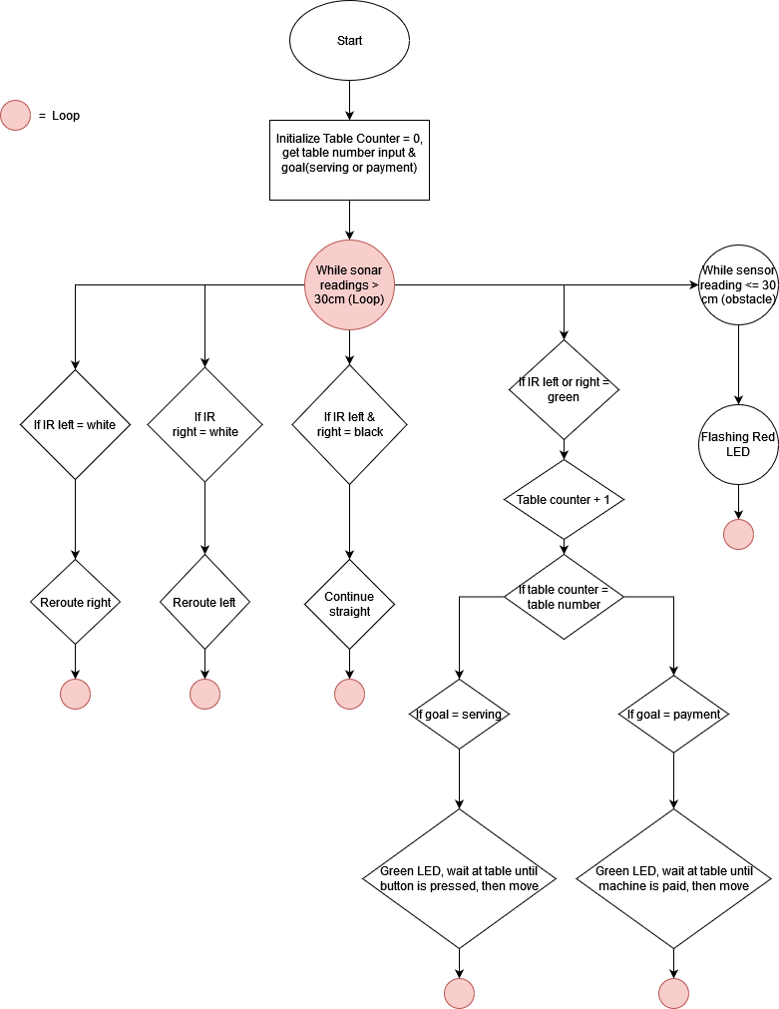
Main Flow Chart
Outlines the algorithm designed for our robot’s autonomous capabilities for serving and payment.

Slide 8
Programming & Logic
Initialize table number and operation settings
While surroundings are clear, follow the path
Takes inputs such as table number and operation(serving or payment) through a local web server page using Raspberry Pi
Waits and flashes red lights when there are obstacles within a 20 cm range; using 6 sonar sensors.
Travels to the selected table/s by following a line and keeping a record of the tables visited along its circular path using analog input of 2 infrared(IR) sensors.
If table is reached, serve food or take payment

Slide 9
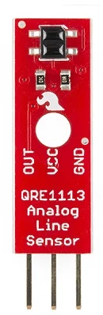
Route Following Algorithm
Left IR sensors not on line: Turn left
Both IR sensors on line:
Continue straight
Right IR sensors not on line: Turn right

Slide 10
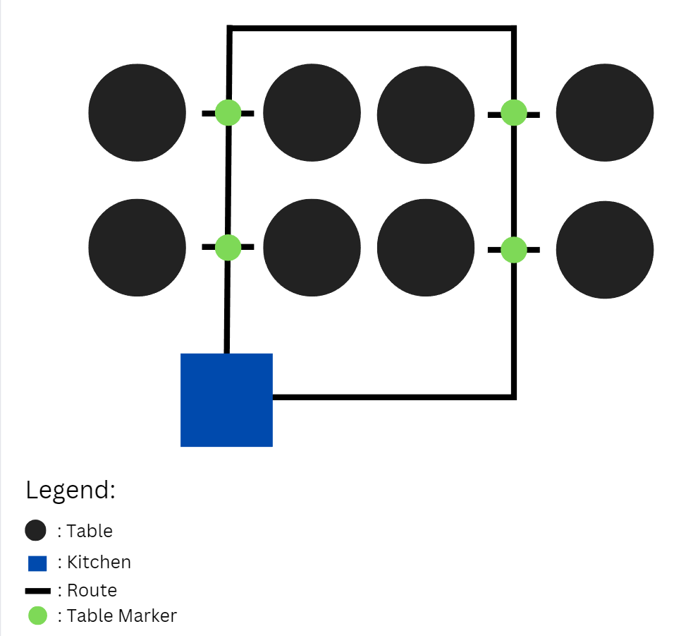
Robot Route Examples and Customizability
Routes within the restaurant that the robot can follow are fully customizable and programmable
The routes are made simple consisting of only the black high emissivity tape and table markers (having an emissivity between 1 and 0)
Hence, this robot can serve a wide variety of locations and table setups

Slide 11
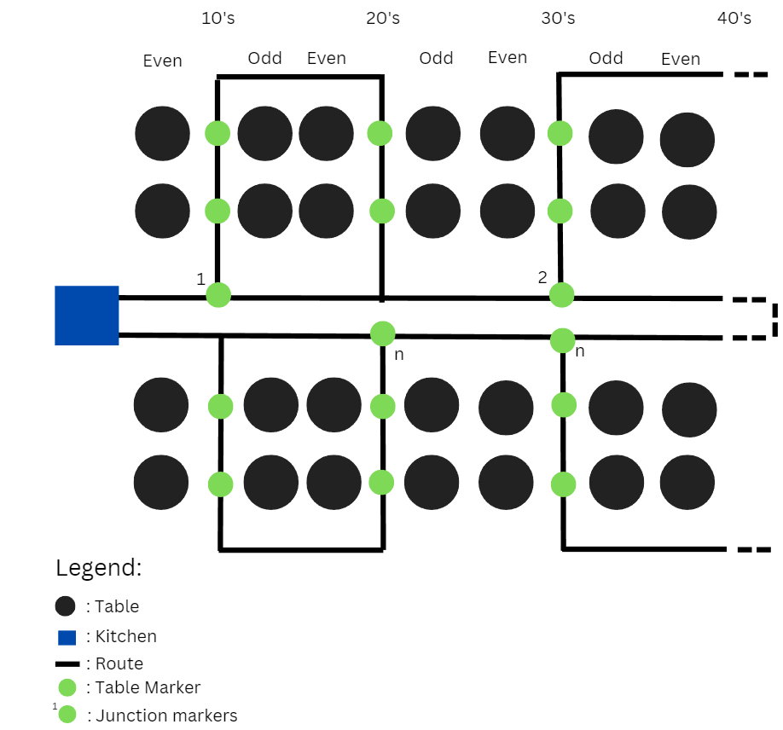
Robot Route Examples and Customizability (Continued)

Slide 12
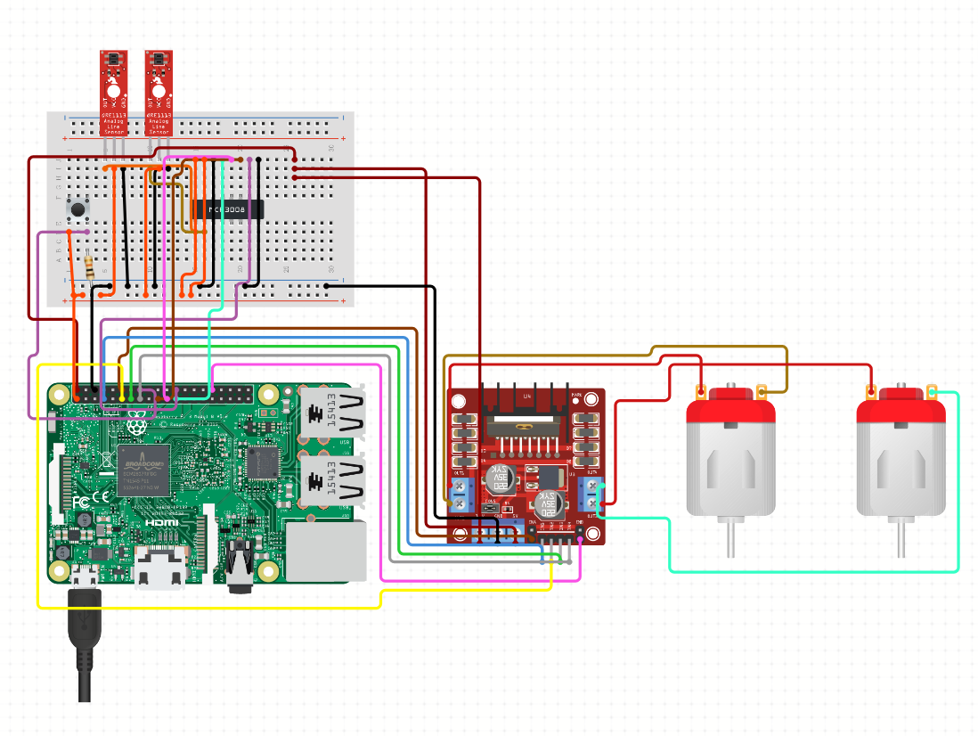
2
Electrical Components Schematic
Raspberry Pi (Serves as the web server)
Infrared Sensors
Button
Motor Driver
DC Motors
Extra Components:
Sonar Sensors
RGB Led Strip
Rechargeable Battery
3
4
5
1

Slide 13
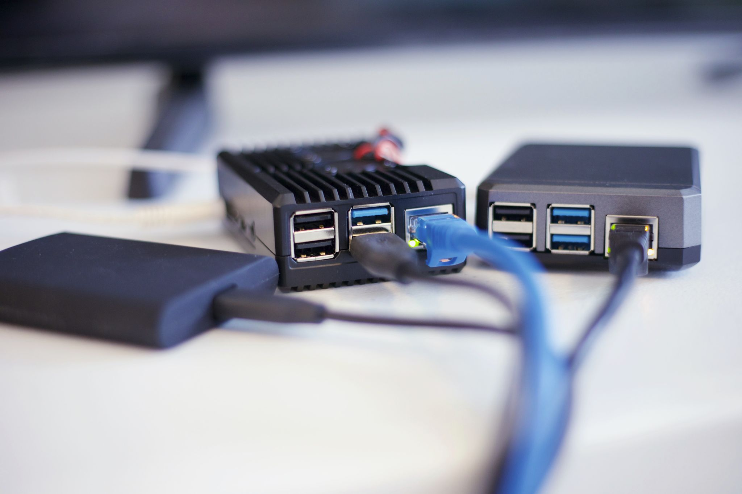
Battery life Calculation
The battery life can be estimated using the following formula:
Battery life = Battery capacity / Load current
The load current is 4.5A (the maximum draw from the circuit calculated) and the battery is 50 Ah
Battery life = 50 Ah / 4.5 A = 11.11 hours (rounded to two decimal places)
As the current drawn won’t be at max load always, we can assume the battery life to be 12 hours.

Slide 14
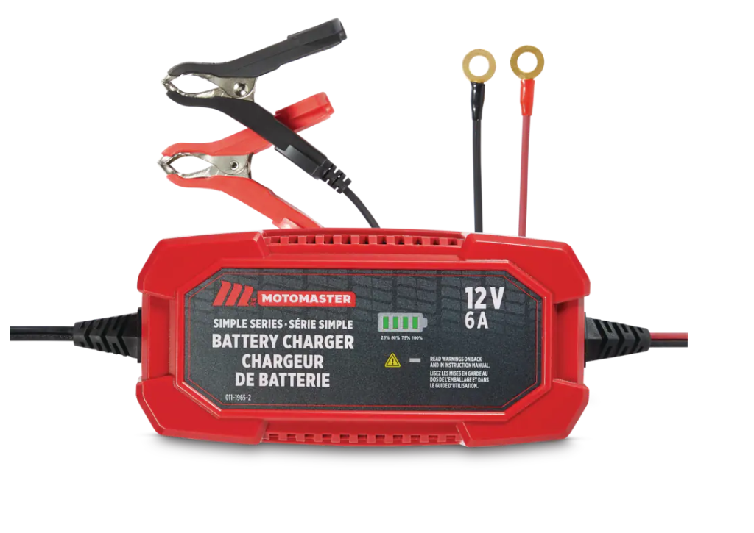
Charging Time Of One Battery (Calculations)
To calculate the charging time, we used the following formula:
Charging time = (Battery capacity / Charging current) x Charging efficiency
Here, the battery capacity is 50Ah, and the charging current is 6A (the maximum current output of the charger).
The charging efficiency can vary depending on factors such as temperature and the condition of the battery, but for LiFePO4 batteries, it is typically around 90%.
Therefore: Charging time = (50Ah / 6A) x 0.9 = 7.5 hours
Hence by swapping the batteries and charging the discharged battery separately, continuous shifts by the robot can be achieved.

Slide 15
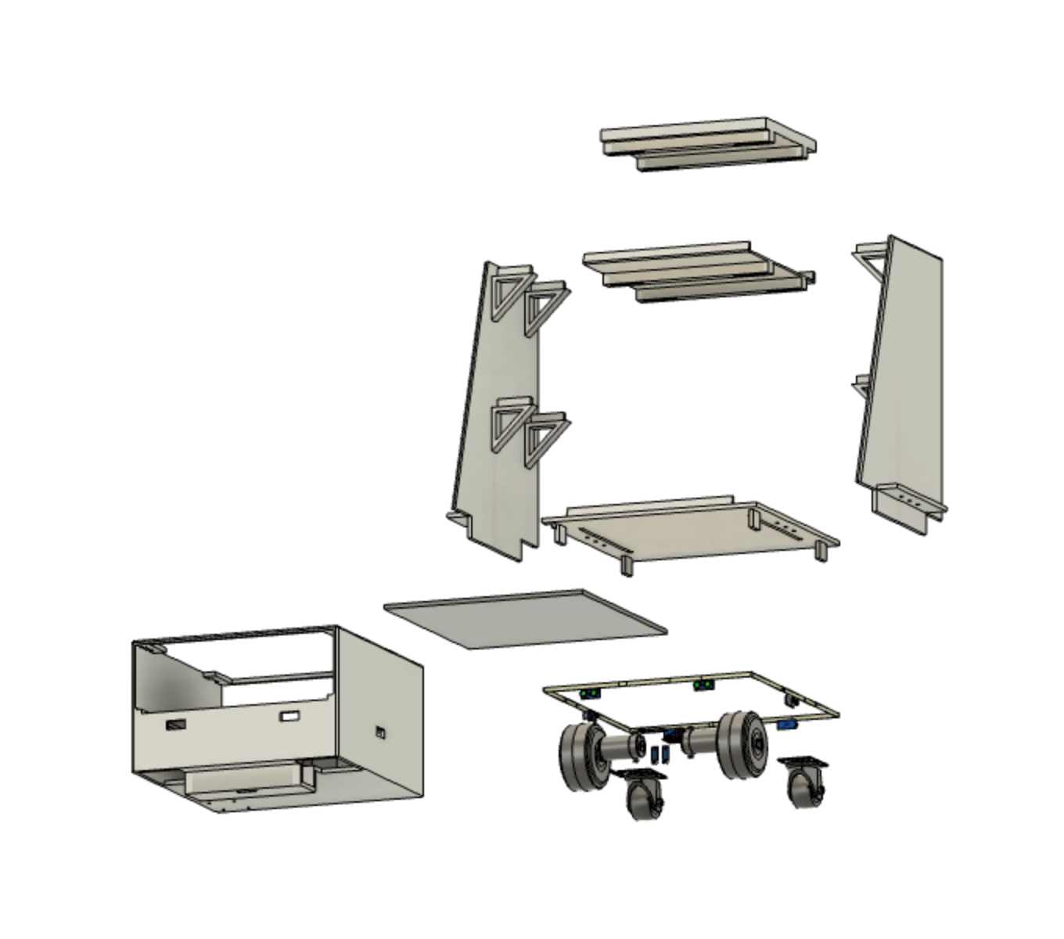
Manufacturing Process
Fused deposition modeling, mass producing highly detailed and complex parts from CAD.
Polylactic acid (PLA), biodegradable and compostable, reduced carbon footprint and waste reduction
Modular tray system, future upgrades/add ons and customizable features..

Slide 16
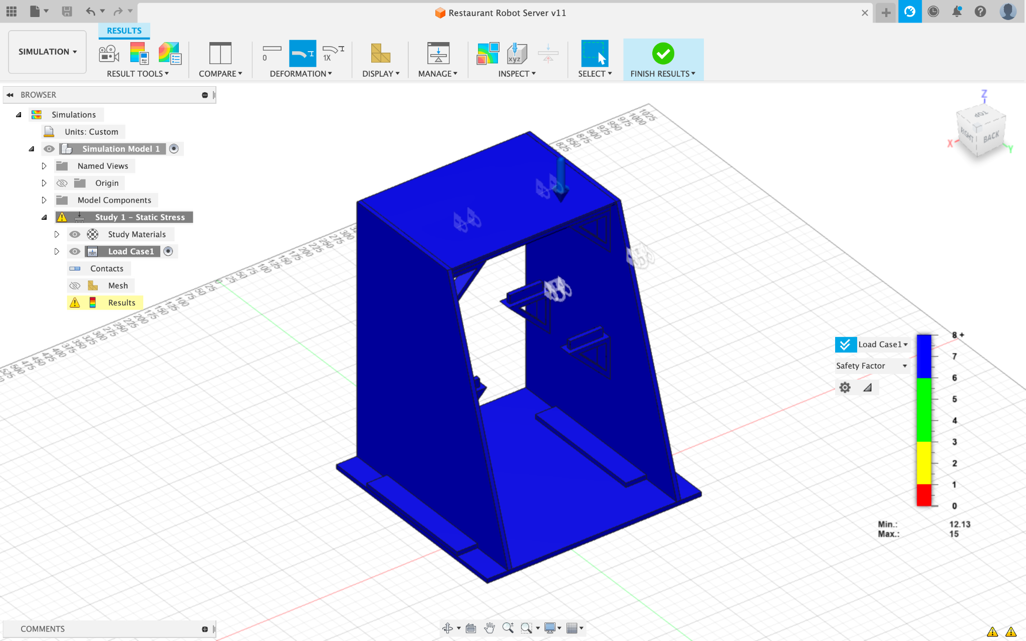
Stress Analysis
Can hold over 15KG
Density of PLA (1.24g/cm^3) increases strength
Total mass robot = 32.7kg

Slide 17
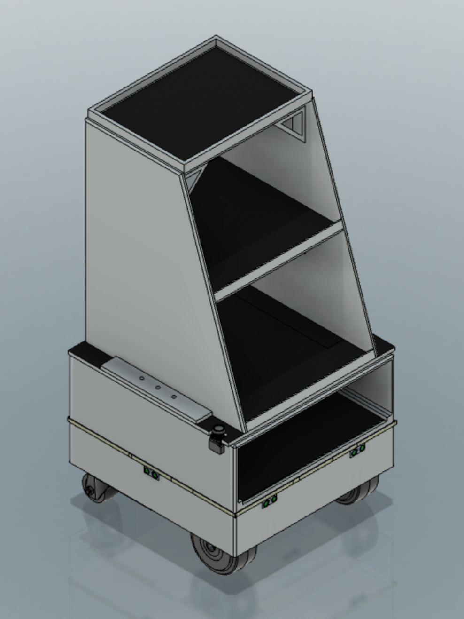
Costs
862.81 (Cost of Components)+ 1090(Cost of Printing)
= 1952.81 USD
In comparison, the competitors prices range from 8000 to 15000 USD
Some of them even charging 1000 USD per month.
Thus it shows that the 4-Ward Thinker is an affordable while an effective option.

Slide 18
Thank You

